Slide 1
Assignment 9 supervised Learning Part 1
5420 Anomaly Detection, Fall 2020
- Harsh Dhanuka, hd2457

Slide 2
5420 Anomaly Detection, Fall 2020
- Harsh Dhanuka, hd2457
Agenda
LOAN DEFAULT
Loan default occurs when a borrower fails to pay back a debt according to the initial arrangement.
Predict which loan holders will likely default
0 = No Default 1 = Default
Which techniques to use?
Which H2O packages to use?
How to convey the results?
Around $20 billion defaults only in student loans in US

Slide 3
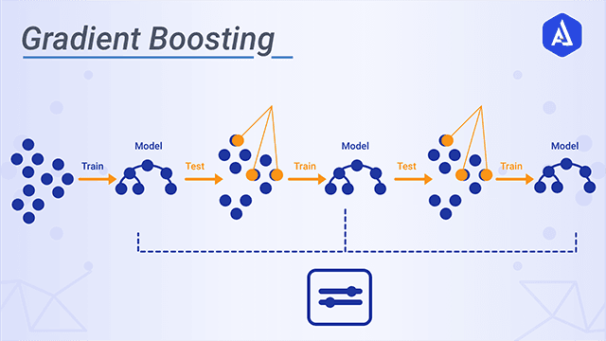
Gradient Boosting
Gradient boosting is a boosting machine learning technique for regression and classification problems, which produces a prediction model in the form of an ensemble of weak prediction models, typically decision trees. It builds the model in a stage-wise fashion like other boosting methods do, and it generalizes them by allowing optimization of an arbitrary differentiable loss function.
H2O
H2O is a fully open source, distributed in-memory machine learning platform with linear scalability. H2O supports the most widely used statistical & machine learning algorithms including gradient boosted machines, generalized linear models, deep learning and more. H2O also has an industry leading AutoML functionality that automatically runs through all the algorithms and their hyperparameters to produce a leaderboard of the best models.

Slide 4
5420 Anomaly Detection, Fall 2020
- Harsh Dhanuka, hd2457
Considerations
1. Feature Engineering
Convert Date/Time columns
Education Code, Gender, City converted to categorical type
Drop empty value variables and constants
Bin the Loan Amount column
2. Missing values
Convert mis-represented NA’s such as -99, to np.nan
Use Iterative Imputer to fill with median
3. Dummy coding of Categorical variables not needed
4. Split to train_test
- I used 75% data in train set. Convert all dataframes to H2O hex format.
Loan Amount Bin ($) Count

Slide 5
5420 Anomaly Detection, Fall 2020
- Harsh Dhanuka, hd2457
Exploratory Data Analysis
1
Distribution of AP006 – OS Type
2
Distribution of Application City (AP007) by the Count of Query in 7 days
Colored by Gender (AP002)

Slide 6
5420 Anomaly Detection, Fall 2020
- Harsh Dhanuka, hd2457
Exploratory Data Analysis
Checking relations between:
AP002 – Gender
AP003 – Education Code
AP004 – Loan Term
3

Slide 7
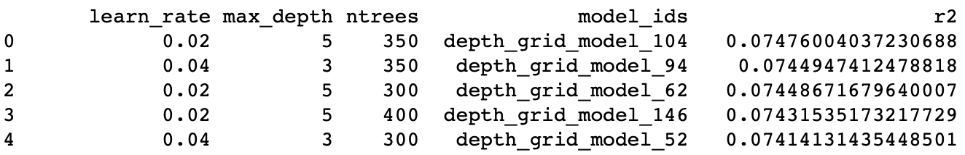
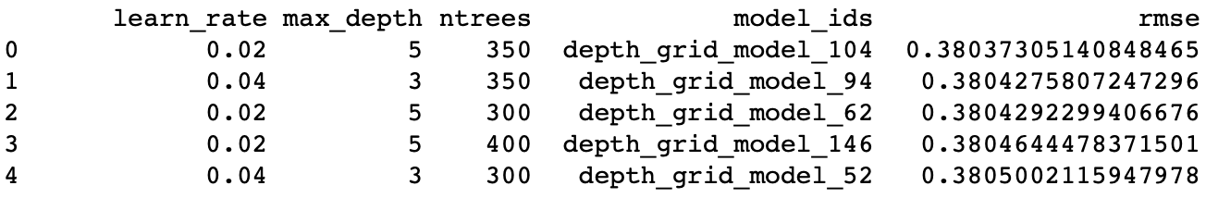
5420 Anomaly Detection, Fall 2020
- Harsh Dhanuka, hd2457
Gradient Boosting Model
1
Run a Basic Model with default parameters
2
Use H2O GBM Grid Search to find optimal parameters
This gives an overall idea of the computational time, and potential output.
learn_rate: [0.01, 0.02, 0.03, 0.04, 0.05, 0.1] max_depth: [2, 3, 4, 5, 6, 7, 8]
ntrees: [200, 300, 350, 400, 450, 500]
Grid Search takes around 10 minutes to run
Best Model is judged by checking R² and rmse scores

Slide 8
5420 Anomaly Detection, Fall 2020
- Harsh Dhanuka, hd2457
Gradient Boosting Model
3
Run and Train GBM Model with optimal parameters
4
Check variable importance and re-run
Out of the total 75 variables, I pick a combination of different number of variables such as top 20, top 30, top 40 and 50 variables to re-run the model.
But, the best Lift score is given when I use all the 75 variables.
After identifying the best parameters, I will run the final GBM model and train it using the train set, and validate it on the test set.
Final Parameters:
ntrees = 350
nfolds = 10
min_rows = 100
max_depth = 5
learn_rate = 0.02
stopping_rounds = 15
balanced_classes parameter did not make any difference in results
19.3% data is minority class

Slide 9
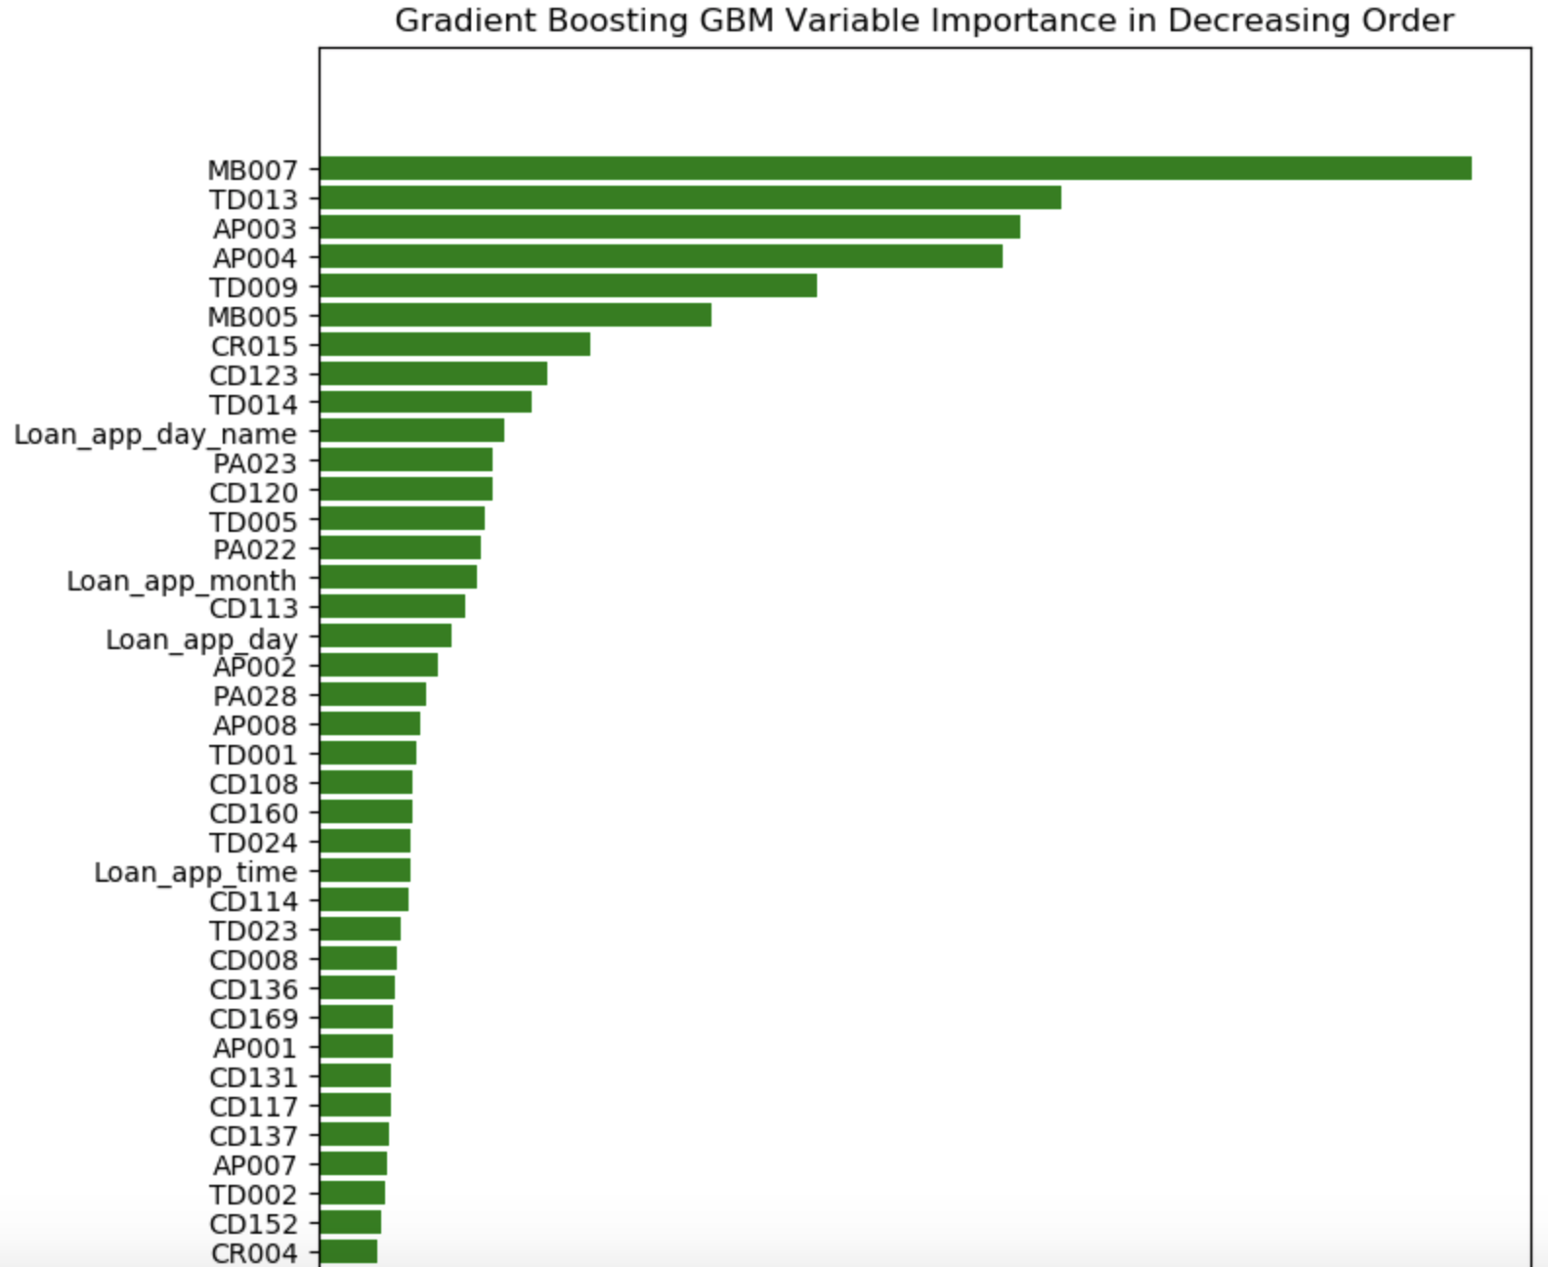
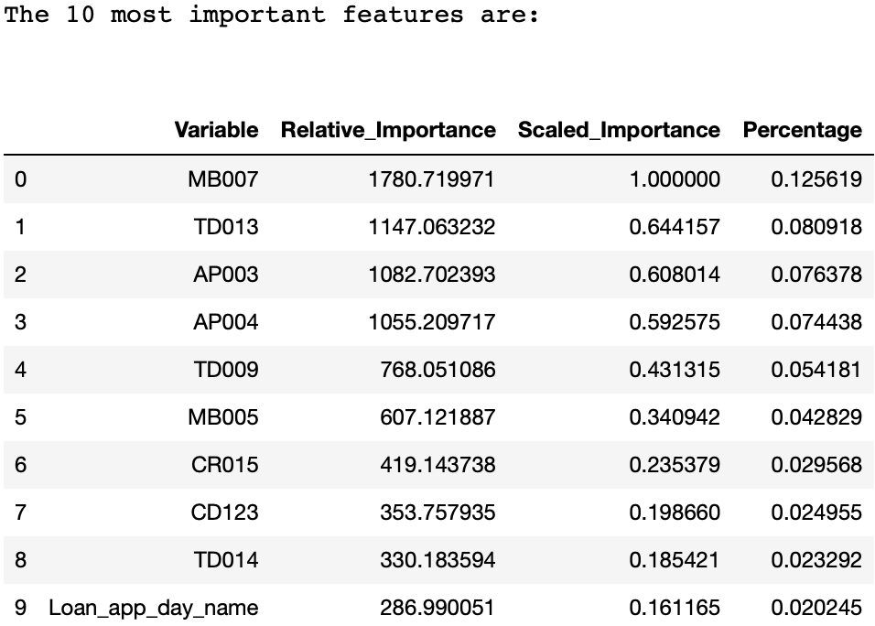
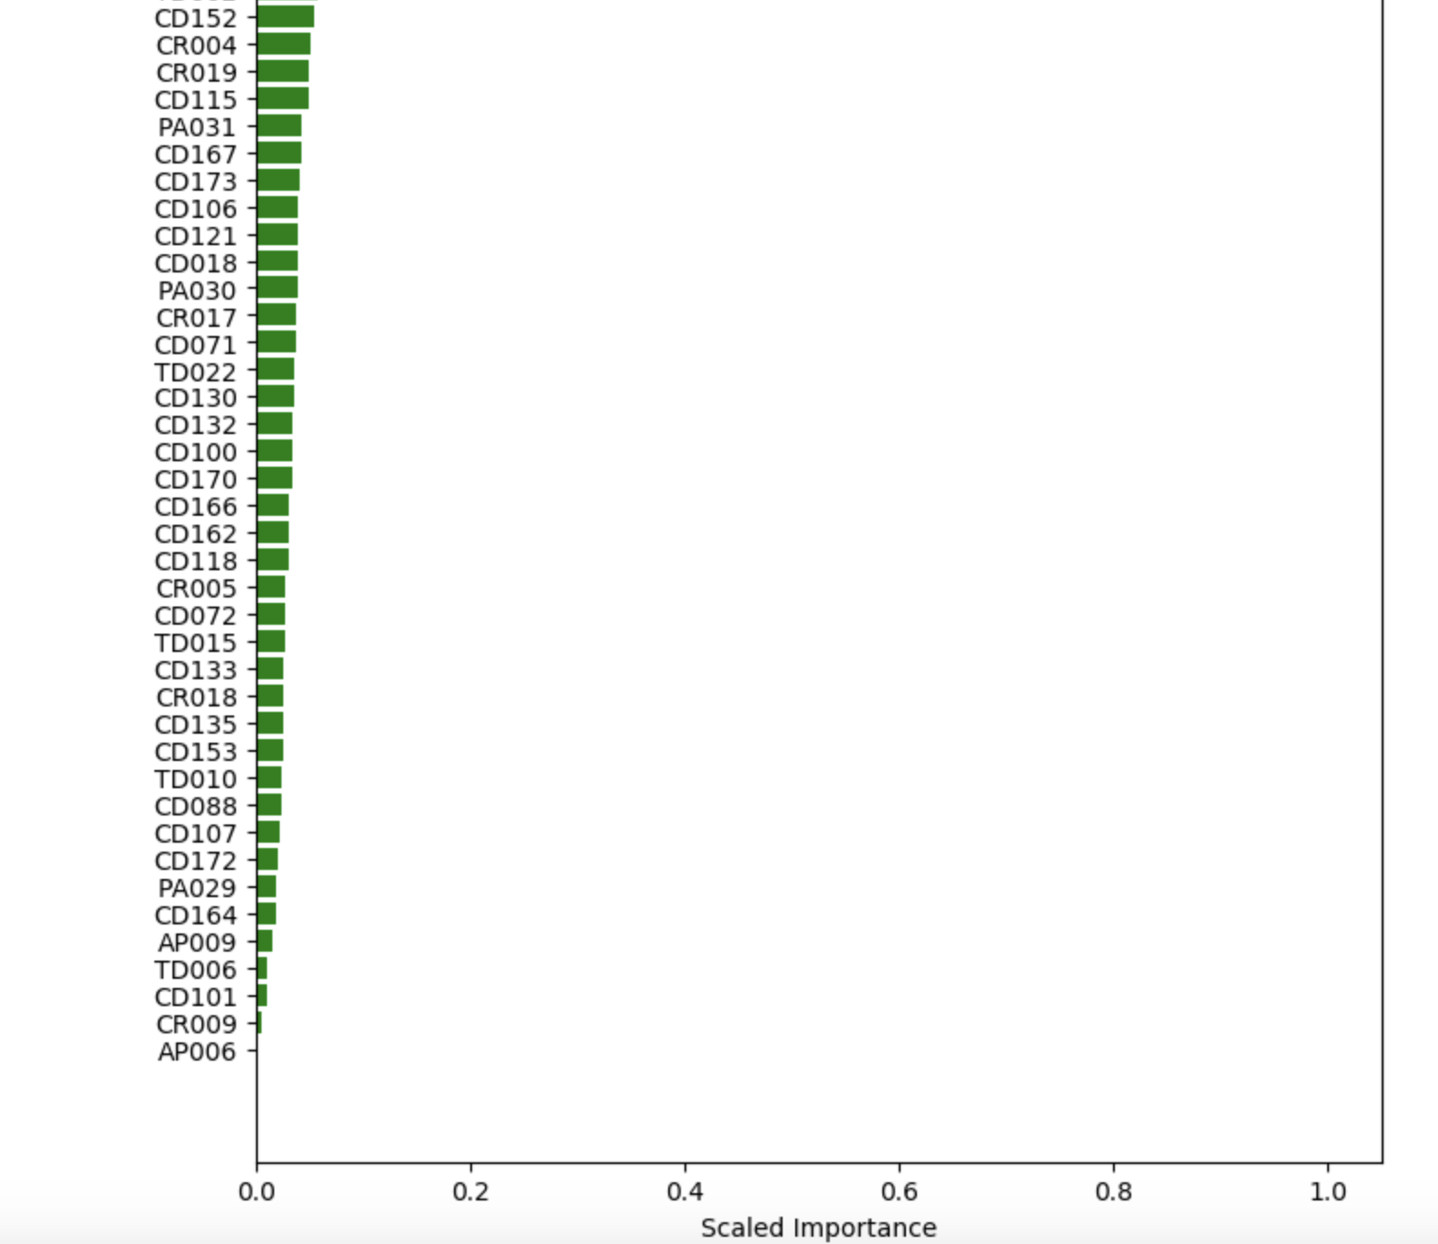
5420 Anomaly Detection, Fall 2020
- Harsh Dhanuka, hd2457
Gradient Boosting Model
5
Feature Importance
MB007 – Type of Device/OS used for Loan application
TD013 – TD Count of Queries in last 6 months (P2P)

Slide 10
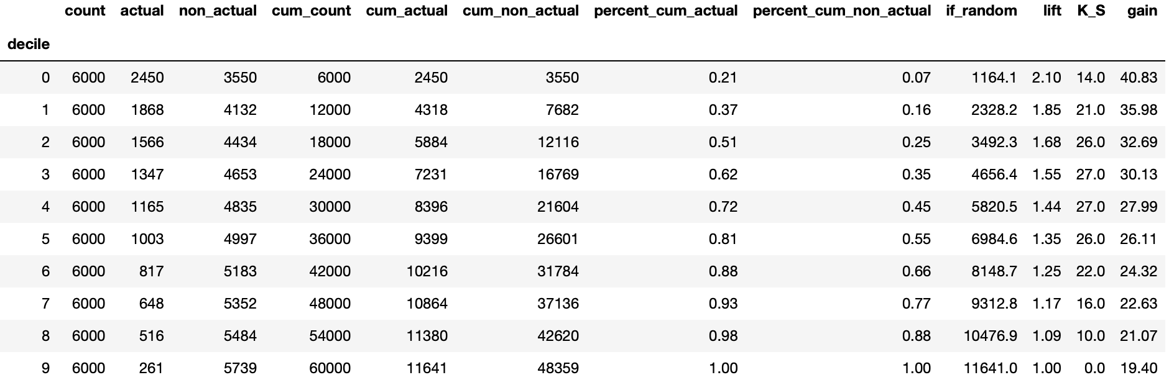
5420 Anomaly Detection, Fall 2020
- Harsh Dhanuka, hd2457
Gradient Boosting Model
6
Gains Table and Lift
Lift is a measure of the effectiveness of a predictive model calculated as the ratio between the results obtained with and without the predictive model.

Slide 11
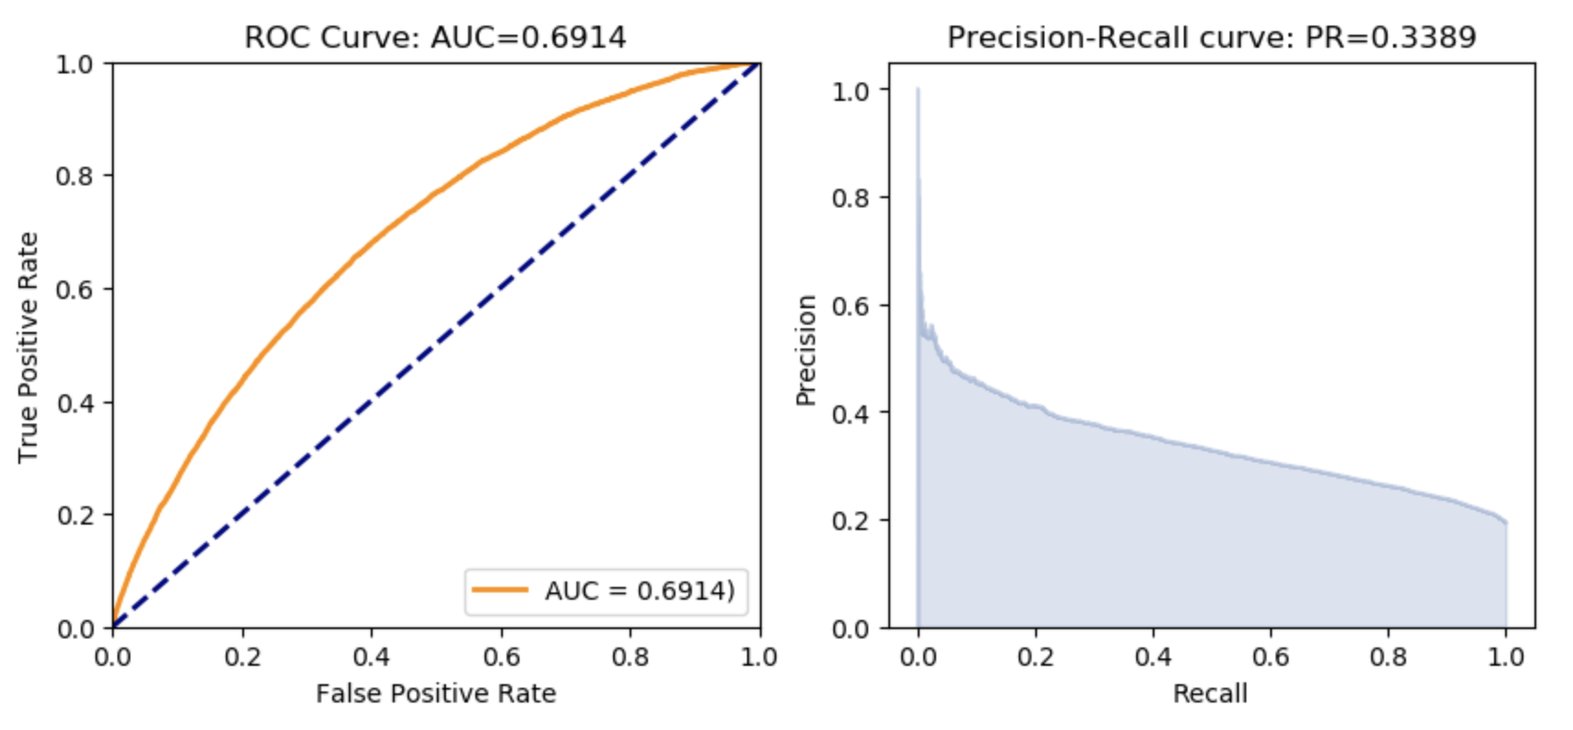
5420 Anomaly Detection, Fall 2020
- Harsh Dhanuka, hd2457
Gradient Boosting Model
7
AUC and Precision Recall
ROC: The ROC curve plots the true positive rate vs. the false positive rate
AUC: A value between 0.5 (random) and 1.0 (perfect), measuring the prediction accuracy
Recall (R) = The number of true positives / (the number of true positives + the number of false negatives)

Slide 12
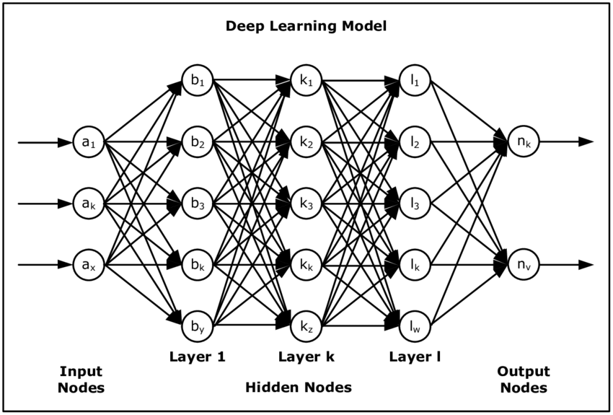
Deep Learning Model
Deep learning (also known as deep structured learning) is part of a broader family of machine learning methods based on artificial neural networks with representation learning. Learning can be supervised, semi-supervised or unsupervised.
Deep learning architectures such as deep neural networks, deep belief networks, recurrent neural networks and convolutional neural networks have been
applied to fields including computer vision, machine vision, speech recognition, natural language processing, audio recognition, social network filtering, machine translation, bioinformatics, drug design, medical image analysis, material inspection and board game programs, where they have produced results comparable to and in some cases surpassing human expert performance.

Slide 13
5420 Anomaly Detection, Fall 2020
- Harsh Dhanuka, hd2457
Business Insight
H2O package - Gradient Boosting, and Deep Learning are both very effective and efficient tools to build a machine learning model for predicting loan defaults. Also, H2O package is very handy to display the variable importance, handle correlations, and also dummy code the categorical variables.
Lift: For the final model I built after tuning all the different models on various different values of each parameter, the highest Lift score I obtained is 2.10, which is acceptable as per industry standards. A Lift score of above 2 is suitable for the model to be of acceptable standards.
AUC is 0.69 and PR score is 0.34 which is of acceptable standards. So the model is stable and fine.
Conclusion:
H2O Random Forest through manual oversampling gave the best Lift score of 3.02 as of now.
Gradient Boosting through the H2O package is a good approach to predict loan default.
However, we should not undermine other good boosting models such as xgboost, or the Auto-ML and others. These might provide better results as well.

